Slide 1
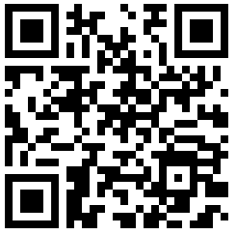
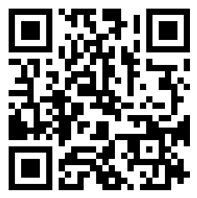
Attendance & Workshop Materials
Attendance
Workshop Materials
1. Click “Clone or Download”
2. Click “Download zip”

Slide 2
Telegram bot
Introduction to telegram bot with python

Slide 3
Objectives
communicate with Telegram Using python
process response
Creating the bot

Slide 4

Taking a step back…
What do we normally use to communicate with Telegram?
The Telegram app that has a User Interface (UI)
What do bots use to communicate with Telegram?
An Application Programming Interface (API)

Slide 5
User
Application
Telegram
User Interface
Bot
Application Programming Interface
Telegram
It's not very effective…

Slide 6
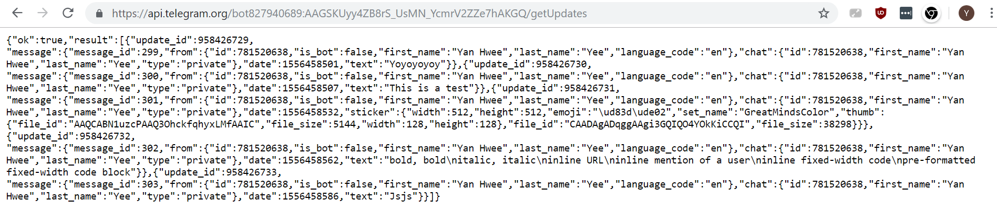

API
https://api.telegram.org/bot827940689:AAGSKUyy4ZB8rS_UsMN_YcmrV2ZZe7hAKGQ/getUpdates

Slide 7
Telegram APIs
Google “Telegram API”
https://core.telegram.org/bots/api
https://core.telegram.org/bots

Slide 8

Communicate with Telegram using Python

Slide 9
Next steps…
User
Bot
Application Programming Interface
Telegram

Slide 10
Requests
Requests is a Python Library / Module
That allows us to deal with HTTP Request easily
User
Web Browser
Telegram
URL
Request
Response
Python
Requests
Telegram
URL
Request
Response
Response

Slide 11
PIP 101 – Installing Requests
Installation (for windows)
Open CMD (as ADMINISTRATOR)
Type: py –m pip install requests
Or: pip install requests

Slide 12
Behold the power of requests
import requests
url = (
'https://api.telegram.org/bot827940689:AAGSKUyy4ZB8rS_UsMN_YcmrV2ZZe7hAKGQ/getUpdates')
response = requests.get(url)
response.json()

Slide 13

Process Response

Slide 14
Lists in python
>>> fruits = ['Apple', 'Pear', 'Strawberry']
>>> fruits[0]
'Apple'
>>> fruits[2]
'Strawberry'
Indices | Elements
0 | 'Apple'
1 | 'Pear'
2 | 'Strawberry'

Slide 15
Dictionaries in python
Indices | Elements
0 | 'Tommy'
1 | 'Male'
2 | 1.85
3 | 92874565
List
person = ['Tommy', 'Male', 1.85, 92874565]
Dictionary
person = {
'name': 'Tommy',
'gender': 'Male',
'height': 1.85,
'contact_no': 92976545
}
Keys | Values
'name' | 'Tommy'
'gender' | 'Male'
'height' | 1.85
'contact_no' | 92874565

Slide 16
Nested dictionary
person = {
'name': 'Tommy',
'gender': 'Male',
'height': 1.85,
'contact_no': '92976545',
'study_at': {
'school_name': 'Ngee Ann Poly',
'address': '535 Clementi Rd, Singapore 599489'
}
}
Keys | Values
'name' | 'Tommy'
'gender' | 'Male'
'height' | 1.85
'contact_no' | '92874565'
'study_at'
Keys | Values
'school_name' | 'Ngee Ann Poly'
'address' | '535 Clementi Rd, Singapore 599489

Slide 17
Traversing a nested dictionary
Keys | Values
'name' | 'Tommy'
'gender' | 'Male'
'height' | 1.85
'contact_no' | '92874565'
'study_at'
>>> person['name']
'Tommy'
>>> person['study_at']
{'school_name': 'Ngee Ann Poly', 'address': '535 Clementi Rd, Singapore 599489'}
>>> person['study_at']['school_name']
'Ngee Ann Poly'
Keys | Values
'school_name' | 'Ngee Ann Poly'
'address' | '535 Clementi Rd, Singapore 599489

Slide 18
More examples
data = {
'Message': {
'From': 'Tommy',
'When': '1 May 2019',
'Text': 'Whassupp'
},
'Update ID': 27382
}
>>> data['Message']['Text']
'Whassupp'

Slide 19
JSON
JSON stands for “JavaScript Object Notation”
Open standard format of transferring data across the web
Very similar to a dictionary in Python

Slide 20

Create the bot

Slide 21
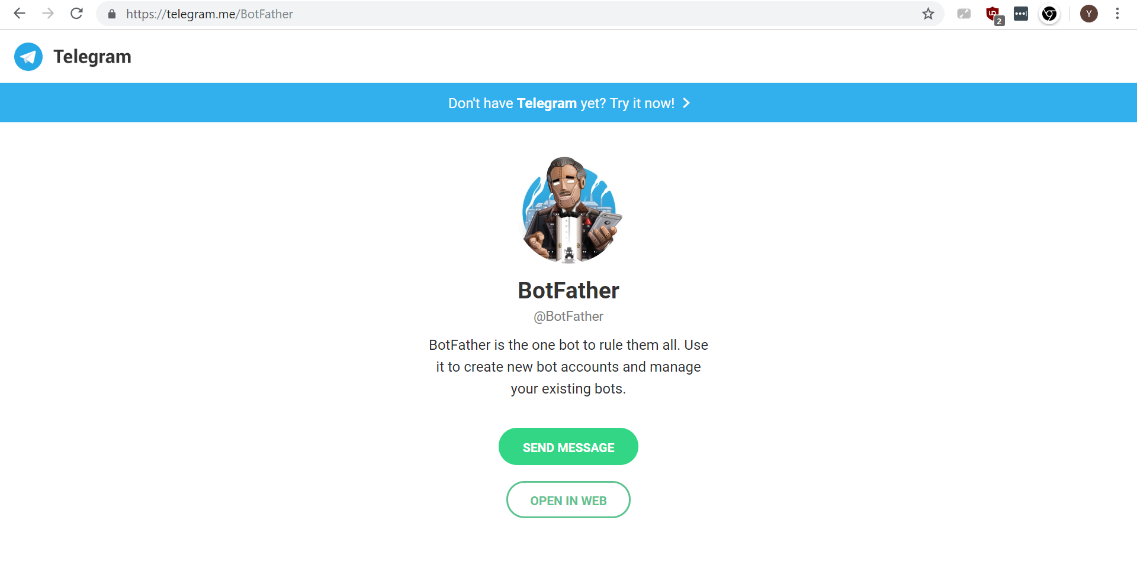
Asking for a bot from Telegram’s BotFather
Method 1
Open Telegram App
Search “botfather”
https://telegram.me/BotFather

Slide 22
Asking for a bot from Telegram’s BotFather
Click /start
Type: /newbot
Give your bot a name
Give your bot a username
Must end with 'Bot'
BotFather will give you a BOT TOKEN.
You'll be needing this to call your bot

Slide 23
Your turn!
Try to complete the code in :
receive_message.py
send_message.py

Slide 24
Mini Telegram Bot Library…
from tbot import TBot
bot = TBot(<bot_token>)
# Receive Message bot.getUpdates()
# Send Message bot.sendMessage(<chat_id>, <text message>)

Slide 25
Activity
Spyfall!
Groups of 4 – 8 pp
Given a bunch of location pre-hand; Randomly choose 1
1 Spy: Guess the location; without getting exposed
3+ Non-Spies: Expose the spy; without making location too obvious
Players take turn asking question to each other.
One question to one player; answerers becomes next questioners.

Slide 26
How it will work
Create New Game
ID: 3657
want new game
Game Room
ID: 3657
Bot
Player
ID: 3657

Slide 27
How it will work
Adding User to Game Room
Game exists? Ok…
want join 3657
Game Room
ID: 3657
Bot
Player
ID: 3657
Player
ID: 2345

Slide 28
How it will work
Create New Game
Room ID: 007
Create new game
Game Room
ID: 3657
Game Room
ID: 007
Bot
Player
ID: 3657
Player
ID: 007
Player
ID: 2345

Slide 29
How it will work
Start Game
Game Room
ID: 3657
Game Room
ID: 007
Start game pls
ok
Player
ID: 3657
Player
ID: 007
Bot
Player
ID: 2345
Spy
Location: Museum Time left: 5 mins

Slide 30
How it will work
Adding User to Game Room
Game Room
ID: 3657
Game Room
ID: 007
Join 007
Player
ID: 3657
Bot
Player
ID: 007
Player
ID: 1234
Player
ID: 2345
Spy
Location: Museum Time left: 3 mins

Slide 31
How it will work
Start Game
Game Room
ID: 3657
Game Room
ID: 007
Player
ID: 3657
Bot
Player
ID: 007
Spy
Player
ID: 2345
Player
ID: 1234
Spy
Location: Train Time left: 10 mins
Location: Museum Time left: 1 mins

Slide 32
How it will work
Check Timeout
Game Room
ID: 3657
Game Room
ID: 007
Time's Up!
Player
ID: 3657
Bot
Player
ID: 007
Spy
Player
ID: 2345
Player
ID: 1234
Spy
Location: Train Time left: 9 mins
Location: Museum Time left: 0 mins

Slide 33
How it will work
Check Timeout
Game Room
ID: 3657
Game Room
ID: 007
Time's Up!
Player
ID: 3657
Bot
Player
ID: 007
Spy
Player
ID: 2345
Player
ID: 1234
Spy
Location: Train Time left: 9 mins
Location: Museum Time left: 3 mins

Slide 34
How it will work
End Game
Game Room
ID: 3657
Deleting Game Room…
Game Room
ID: 007
End Game
Player
ID: 3657
Bot
Player
ID: 007
Spy
Player
ID: 2345
Player
ID: 1234
Spy
Location: Train Time left: 8 mins
Location: Museum Time left: 2 mins

Slide 35
How it will work
Game Room
ID: 007
Create Game
Join Game
Start Game
Check Timeout
End Game
Player
ID: 007
Bot
Spy
Player
ID: 1234
Location: Train Time left: 10 mins

Slide 36
SPYFALL WALKTHROUGH
Open spyfall.py
Complete the code in the functions
create_new_game
add_user
start_game
end_game

